Slide 1
Tutorial 3

Slide 2
Assignment 1 comments
A few comments:
A bug was fixed Friday ensuring that CodeGrade’s version of MySQL is no longer case sensitive
This does mean that some submissions that only worked because it was case sensitive no longer works
If yours stopped working and you are not sure why, ask…
When you upload, please only incl. CREATE TABLE statements, CREATE VIEW statements and comments
It is mentioned at the start of the assignment as well, but some seem to overlook it
(INSERT INTO statements or similar are fine as well, but the data will be removed before your database is tested, so you might as well not incl. them…)
In particular, do NOT write CREATE DATABASE statements or USE statements!
It might work fine for the public data, but the private data is loaded into another database
I.e. your sql file is used to create two databases: cs_store and cs_store_private_data (and the insert commands are then run and finally we run the checks) – Note, the private part is first done after the deadline (it is not even created)
This also means that you should NOT write CREATE TABLE cs_store.Customers or anything like that
It would again work fine for the public data but not for the private
(this command creates the table in the cs_store database instead of whatever database is currently used – it has not nor will it be introduced in the course except for here)
Similarly, using FROM cs_store.Customers will lead you to the same issue.

Slide 3
ACID
This weeks topic is the first on Transaction management (i.e. we have lists of commands from multiple users and wants to run them all well)
We heard about ACID:
A: Atomicity – Everything or nothing
C: Consistency – somewhere between constraints are satisfied, up to matches the real world
I: Isolation – The effect matches each transaction executing alone in some order
D: Durability – Transactions that have committed does not later get undone

Slide 4
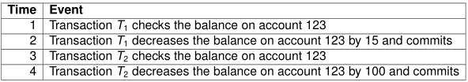
Exercises: Question 1
Consider the following schedule $S_{1}$:
How would you write it in short-hand notation (say if the balance on account 123 was record X – just as a reminder: non-database operations should not be incl.)?
Hopefully easy: Is it a serial schedule? A conflict-serializable schedule? A serializable schedule? A concurrent schedule?
Consider which ACID properties are broken (hint: CID should be easy for this one…) if the server crashes and does nothing after restart:
Before starting the event at time 1?
After the event at time 1 is fully done, but before starting the event at time 2?<- people seems to struggle with this one
After the event at time 2 is fully done, but before starting the event at time 3?

Slide 5
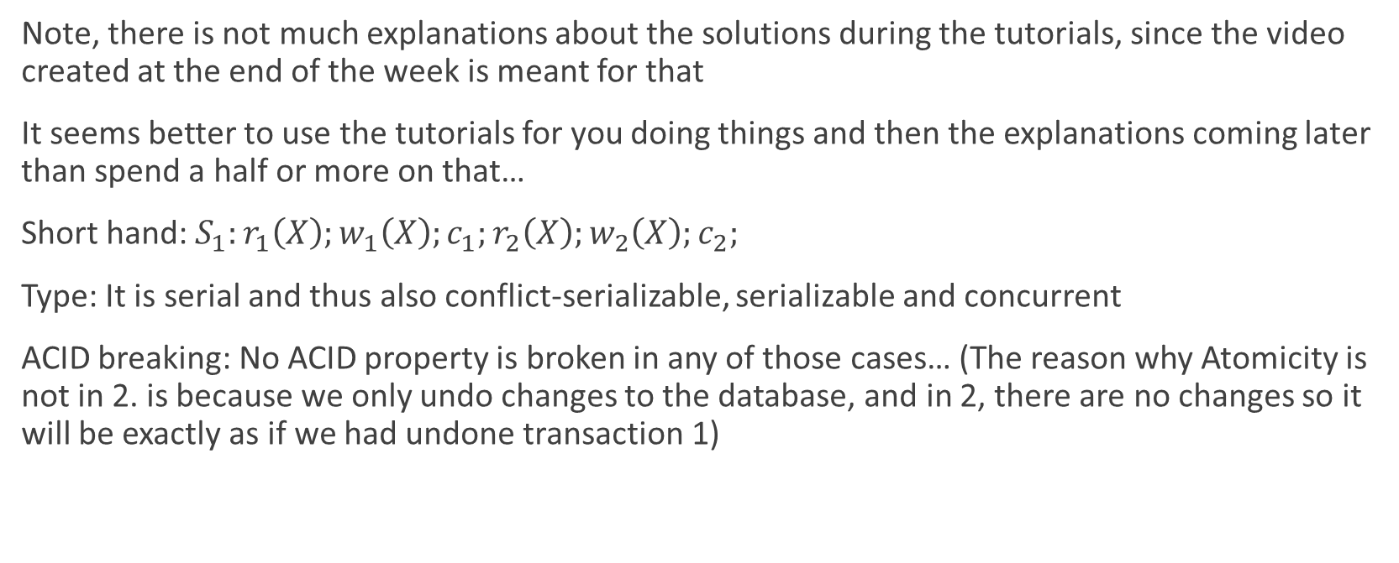
Solution to question 1
Note, there is not much explanations about the solutions during the tutorials, since the video created at the end of the week is meant for that
It seems better to use the tutorials for you doing things and then the explanations coming later than spend a half or more on that…
Short hand: $S_{1}:r_{1}\left(X\right);w_{1}\left(X\right);c_{1};r_{2}\left(X\right);w_{2}\left(X\right);c_{2};$
Type: It is serial and thus also conflict-serializable, serializable and concurrent
ACID breaking: No ACID property is broken in any of those cases… (The reason why Atomicity is not in 2. is because we only undo changes to the database, and in 2, there are no changes so it will be exactly as if we had undone transaction 1)

Slide 6
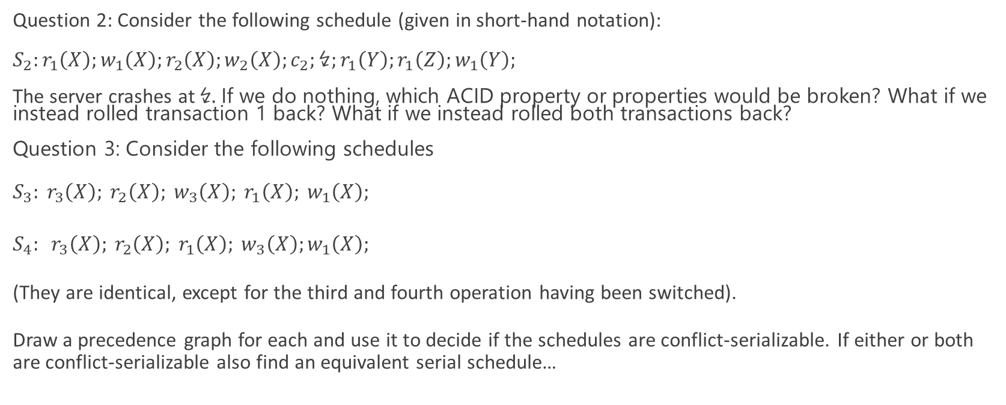
Exercises: Question 2 and 3
Question 2: Consider the following schedule (given in short-hand notation):
$S_{2}:r_{1}\left(X\right);w_{1}\left(X\right);r_{2}\left(X\right);w_{2}\left(X\right);c_{2};↯;r_{1}\left(Y\right);r_{1}\left(Z\right);w_{1}\left(Y\right);$
The server crashes at ↯. If we do nothing, which ACID property or properties would be broken? What if we instead rolled transaction 1 back? What if we instead rolled both transactions back?
Question 3: Consider the following schedules
$S_{3}: r_{3}\left(X\right); r_{2}\left(X\right); w_{3}\left(X\right); r_{1}\left(X\right); w_{1}\left(X\right);$
$S_{4}: r_{3}\left(X\right); r_{2}\left(X\right); r_{1}\left(X\right); w_{3}\left(X\right);w_{1}\left(X\right);$
(They are identical, except for the third and fourth operation having been switched).
Draw a precedence graph for each and use it to decide if the schedules are conflict-serializable. If either or both are conflict-serializable also find an equivalent serial schedule…

Slide 7


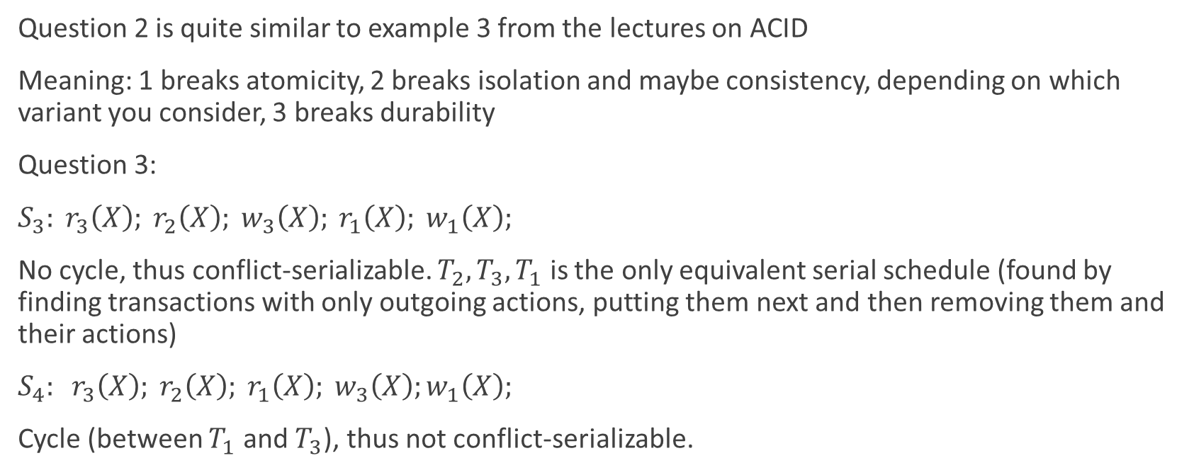
Solution to question 2-3
Question 2 is quite similar to example 3 from the lectures on ACID
Meaning: 1 breaks atomicity, 2 breaks isolation and maybe consistency, depending on which variant you consider, 3 breaks durability
Question 3:
$S_{3}: r_{3}\left(X\right); r_{2}\left(X\right); w_{3}\left(X\right); r_{1}\left(X\right); w_{1}\left(X\right);$
No cycle, thus conflict-serializable. $T_{2},T_{3},T_{1}$ is the only equivalent serial schedule (found by finding transactions with only outgoing actions, putting them next and then removing them and their actions)
$S_{4}: r_{3}\left(X\right); r_{2}\left(X\right); r_{1}\left(X\right); w_{3}\left(X\right);w_{1}\left(X\right);$
Cycle (between $T_{1}$ and $T_{3}$), thus not conflict-serializable.

Slide 8

Exercises: Question 4
Explain how, for any $n > 1$, one can find a schedule whose precedence graph has a cycle of length $n$, but no smaller cycle. (This is a simpler version of the exercise above the video in ”Recognizing a conflict-serializable schedule”, but the solution gives you a fairly strong hint to solving that)
(if you managed to do that one, you could look at your assignment…)

Slide 9
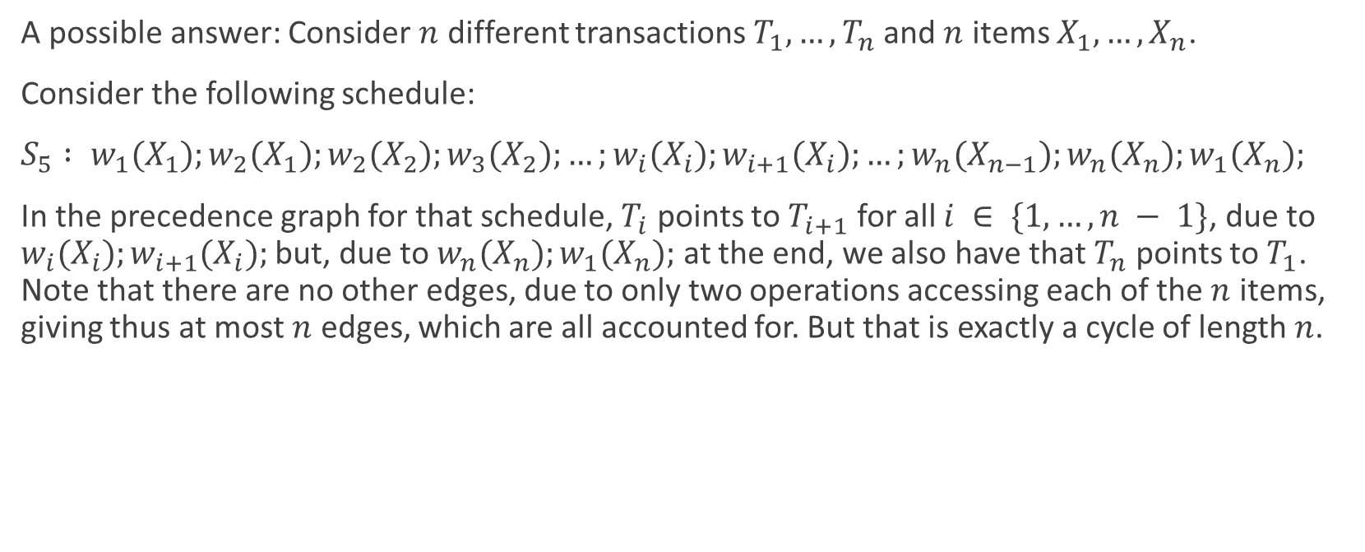
Solution: question 4
A possible answer: Consider $n$ different transactions $T_{1},…,T_{n}$and $n$ items $X_{1},…,X_{n}$.
Consider the following schedule:
$S_{5} : w_{1}(X_{1});w_{2}(X_{1});w_{2}(X_{2});w_{3}(X_{2});…;w_{i}(X_{i});w_{i+1}(X_{i});…;w_{n}(X_{n−1});w_{n}(X_{n});w_{1}(X_{n});$
In the precedence graph for that schedule, $T_{i}$ points to $T_{i+1}$ for all $i ∈ \{1,…,n − 1\}$, due to $w_{i}(X_{i});w_{i+1}(X_{i});$ but, due to $w_{n}(X_{n});w_{1}(X_{n});$ at the end, we also have that $T_{n}$ points to $T_{1}$. Note that there are no other edges, due to only two operations accessing each of the $n$ items, giving thus at most $n$ edges, which are all accounted for. But that is exactly a cycle of length $n$.

